Slide 1

WELCOME
WELCOME

Slide 2
I
INTRODUCTION
Asma Akter
Assistant Head teacher
Mofiz Uddin Khan High School
B.O.F, Sadar, Gazipur
Class : Eight
Subject : English 2nd paper
Notes:
l

Slide 3
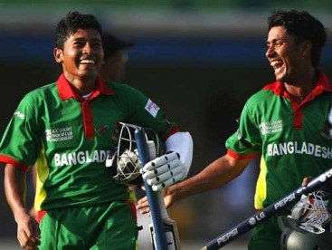
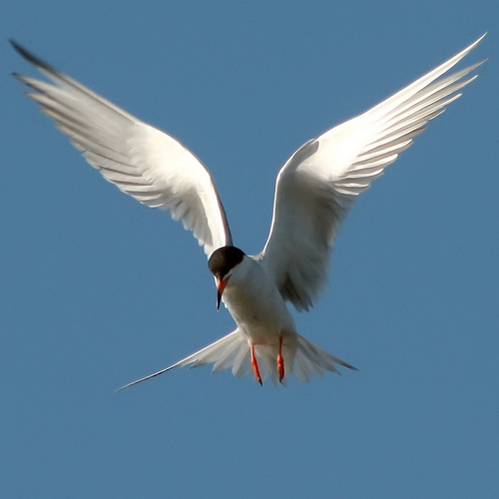



Mushfiq and Ashraful are cricket players.
A bird can fly but a fish can swim.
You can take the sunflower or the rose

Slide 4
CONJUNCTION

Slide 5
Learning outcomes:
By the end of the lesson students will be able to…
1.Define and give examples of conjunction.
2.Find out conjunctions.
3. Practice using conjunctions

Slide 6



Look at the pictures:
A boy and a girl
Walk fast or you will miss the class.
The water of the glass is clean so you can drink it.

Slide 7
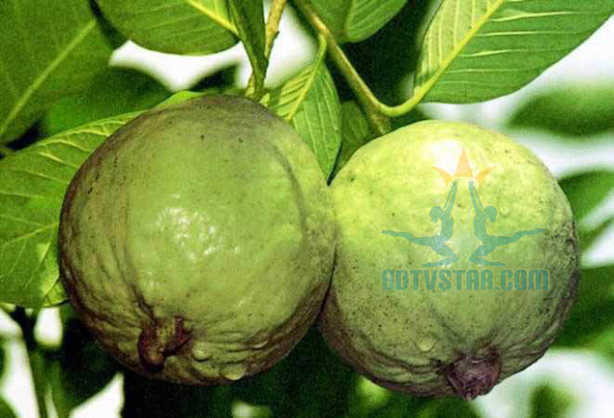
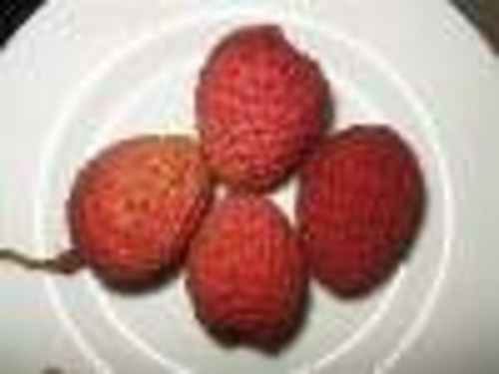


Two guavas
Four liches
Computer

Slide 8
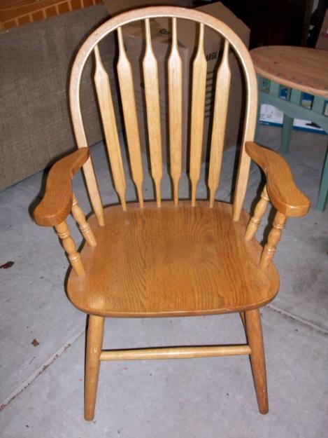
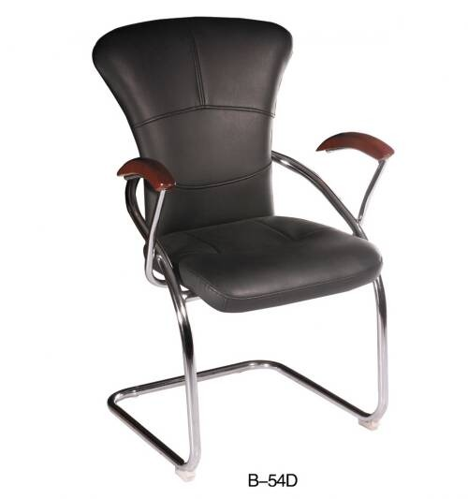
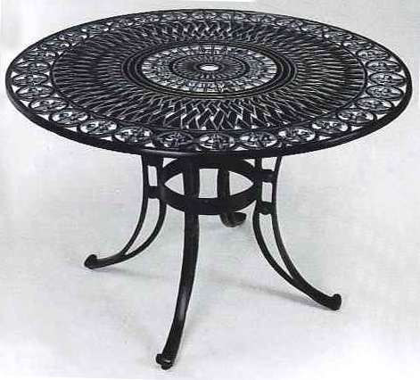
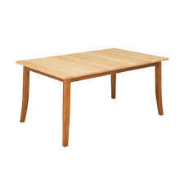
A rocking chair
A chair
A table
A round table
Notes:
A

Slide 9
Read the sentences and find out conjunctions :
1.The Padma and the Jamuna are big rivers.
2.Take exercise or you will be sick.
3.Bangladesh is a small but beautiful country.
4.Mithila was a meritorious girl so she got GPA-5.
5.Though the man was rich he was unhappy.
6.He could not come since he was tired .

Slide 10
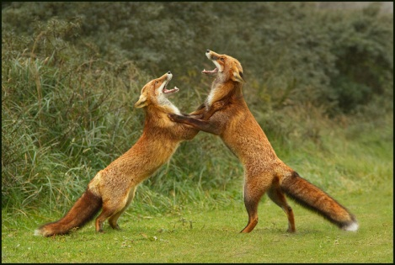
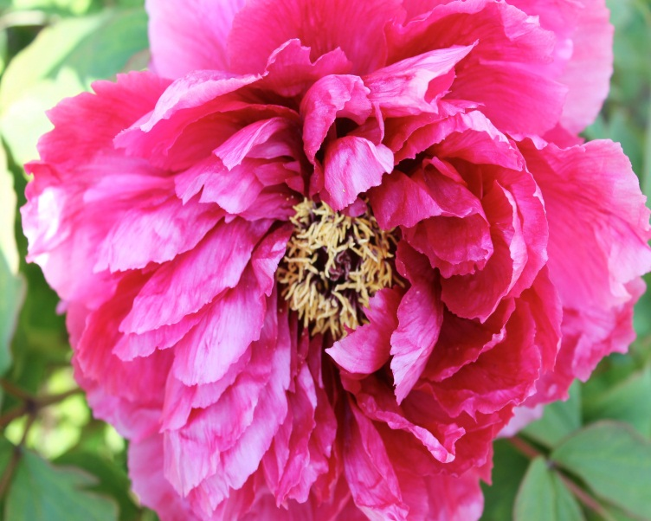
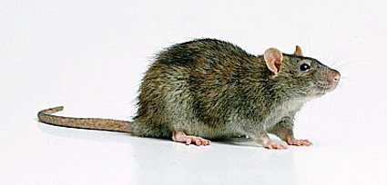
The foxes are so ferocious that they are fighting.
The flower is so nice that everybody likes it.
The rat is so naughty that it always run

Slide 11
Now we will learn more about conjunctions:
Neither he nor his brother had enough money.
Either Susan or Sawon was absent.
Both Mina and Mounata are happy.
Robindranath Tagore was not only a writer but also a dramatist.
These are called paired conjunction because they are used in pair.

Slide 12
Let us watch a video
https://www.youtube.com/watch?v=RKlvpPBh8Pc

Slide 13
Evaluation:
1.What is conjunction? Give some examples.
2.Find out conjunctions from the sentences.
a)Karim and Rahim are brothers.
b)He is strong but lazy.
c)Work hard or you will not shine in life..
d)Rana could not come as he was sick.
e)He was honest for everybody liked him.

Slide 14

HOME WORK
Make ten sentences using conjunctions.

Slide 15

THANK YOU

